Slide 1
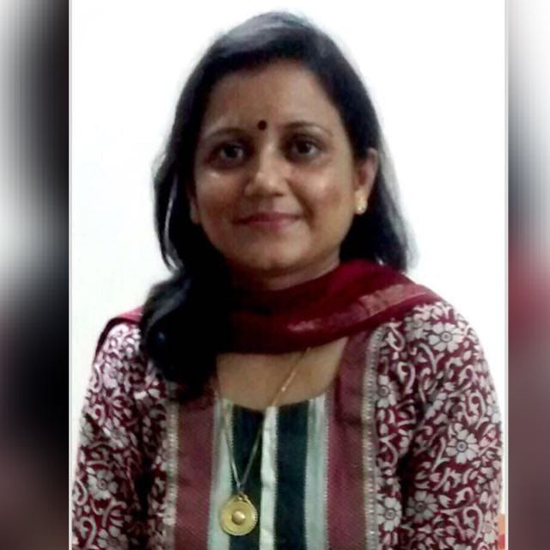
Dr K Usha Rani
Senior specialist & Professor, VMMC and Safdarjung Hospital, New Delhi
Designated UG and PG teacher
Authored several original research paper and case reports in national and international journal
Peer reviewer – International Journal JPRI
Trainer Daksh National Skill Lab and comprehensive abortion case
Member CME committee AOGD 2021
Area of interest – High risk pregnancy and critical care in obstetrics

